Slide 1

Project Presentation
EMPLOYEE DETAILS ANALYSIS
Project By:
RAKSHITHA M
AF0377829
Guide:
Mr. SIVAKUMAR SELVAM

Slide 2

INTRODUCTION
Begin by introducing the new employee with some personal details such as their name, position, anticipated start date, and a succinct resume of the professional experience. This information helps colleagues understand their role and background. An Employee Database is a system that allows an organization to track employee information. The system can store data about employees, such as their name, contact information, job title, and department. The system can also store data about employees’ performance, such as their reviews, goals, and objectives. An Employee Database can be helpful for companies that need to track employee information for a variety of reasons, such as human resources, payroll, and performance management.

Slide 3

DESCRIPTION OF DATASETS
Employee_id
Manager_id
Department_id
Employee_name
Email
Phone_no
Hire_date
Job_id
Salary
No_of_projects
Working_hours

Slide 4
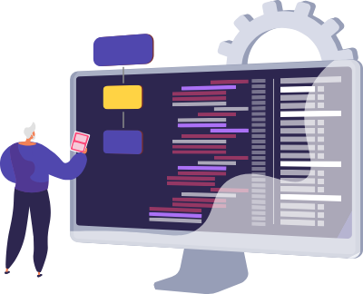
HARDWARE AND SOFTWARE
REQUIREMENTS
Hardware Requirements:
Hard Disk : 512GB
Ram : 8GB
Input Devices : Keyboard, Mouse.
Software Requirements:
Operating System : Windows 64-bit
Programming Language : Python
Python Libraries : Pandas, Numpy, Matplotlib, Seaborn.
IDE : Jupyter notebook

Slide 5
PROBLEM STATEMENT
Store employee personal details such as name, contact information, address, date of birth, etc.
Maintain records of employee job-related information including position, department, salary, employment status, etc.
Allow for easy retrieval and updating of employee information.
Ensure data security and privacy compliance.
Facilitate reporting and analysis of employee data for HR and managerial purposes.
Scale to accommodate a growing number of employees and data.
Provide a user-friendly interface for HR personnel and administrators to interact with the database.

Slide 6
CONCLUSION
In conclusion, the implementation of an employee details database serves as a fundamental cornerstone in the efficient management of human resources within an organization. By systematically organizing and storing comprehensive employee information, ranging from personal details to job-related data, the database facilitates streamlined HR processes. It enables quick access to crucial employee information, aids in decision-making processes related to workforce management, and ensures compliance with data privacy regulations. Additionally, the database empowers HR professionals and managers with valuable insights through reporting and analysis tools, contributing to strategic planning and organizational development.

Slide 7
Thank you

